Slide 1
Topic: Superannuation
EQ: What is superannuation?
Ms. Latham

Slide 2
Topic: Superannuation
EQ: What is superannuation?
Money that you and your employers put into a special fund during your working life to provide you with money to live on when you retire.
Definition
Government legislation
requires all Australian employers to contribute to superannuation on behalf of their employees aged between 18 and 70 years who earn more than $450 per month. The minimum contribution rate is currently 9.5%
Less than 18 and work less than 30 hours per week your employer is not required to pay superannuation for you
How do we find percentage of a number?
Find 1% by dividing by 100
Multiply that by 9 to get to 9% (or whatever percentage you need to get to)
Or Multiply by 9.5 to get to 9.5%

Slide 3
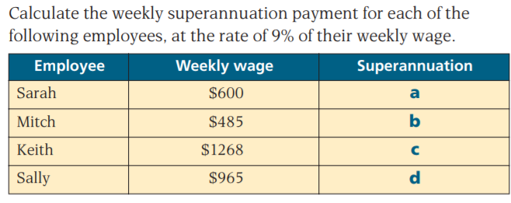
Practice on LHS

Slide 4
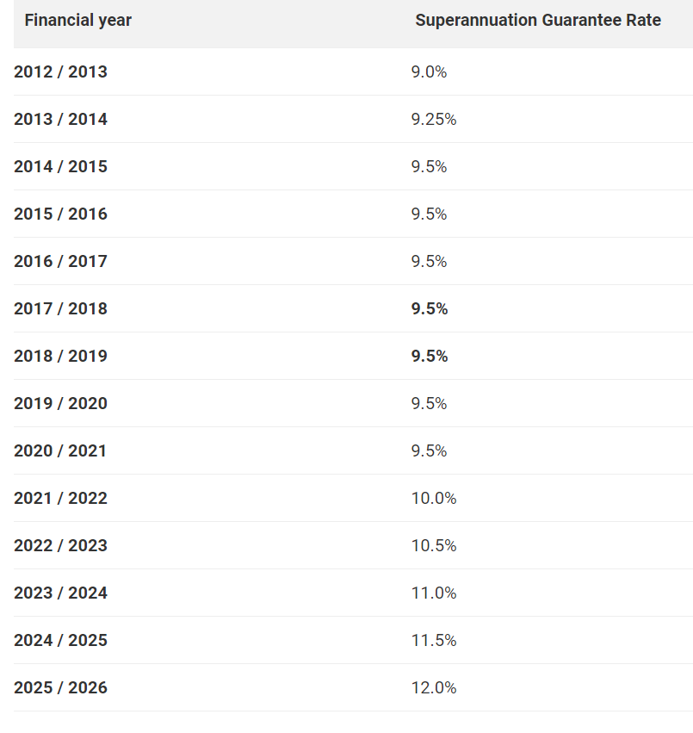
Superannuation Contribution
www.superguide.com.au
Why are the contribution rates increasing???

Slide 5
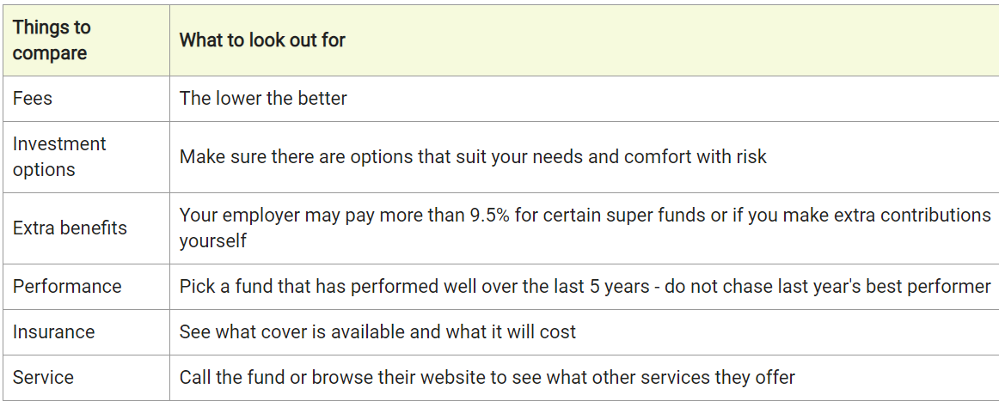
Topic: Superannuation
EQ: What is superannuation?
What happens to your money when its in super?
Your money is pooled with other members’ money and invested on your behalf by professional investment managers.
Generally you will not be able to access this money until you retire
How to choose a super fund?
Most super funds let you choose from a range of investment options, depending on how much risk you are willing to take.
Lower Risk Higher Risk
- Lower returns - Higher returns
Balanced Risk
combination

Slide 6
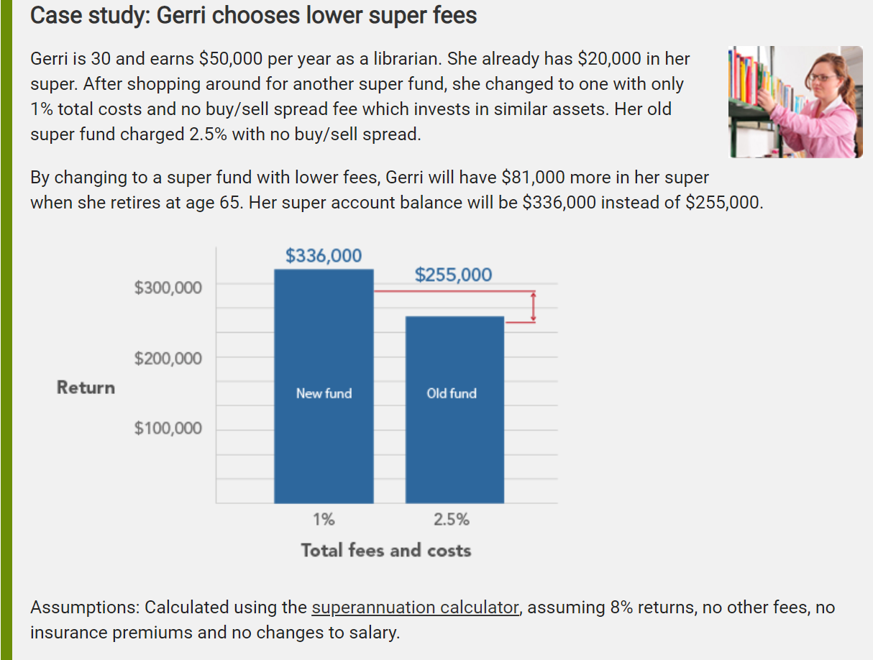
Why are fees important?

Slide 7
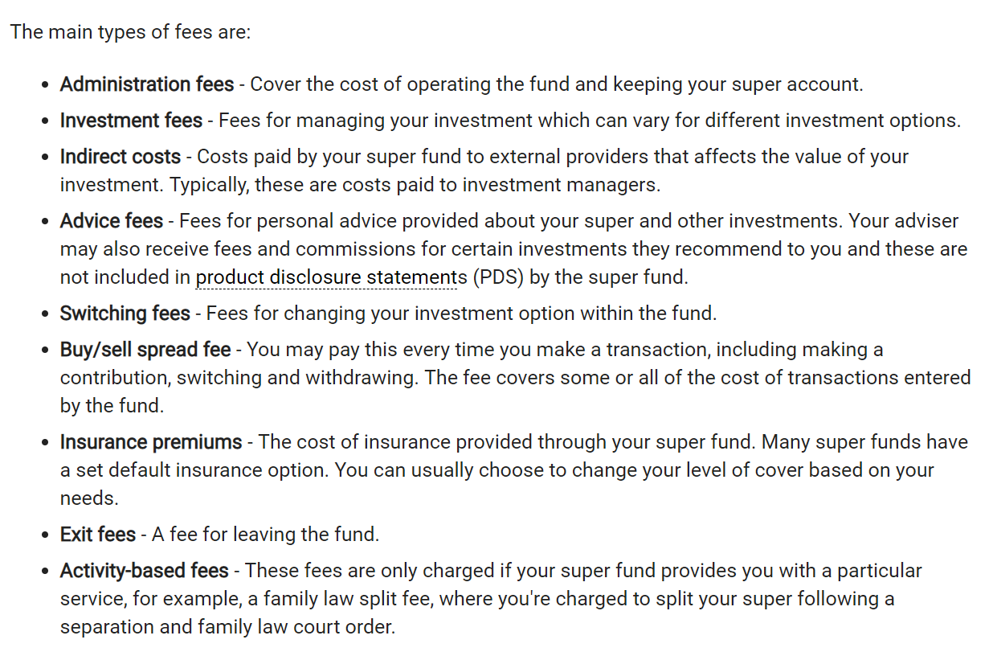
Fees to look out for
Where can you find out about your super fees?
PDS (product disclosure statement) available on the website
Your annual statement
You may be paying fees for services you are not using, for example financial advice.
You can call up and enquire about no longer paying for the services you aren’t using

Slide 8

https://www.moneysmart.gov.au/tools-and-resources/calculators-and-apps/superannuation-calculator

